Slide 1
Backgroung jobs with hangfire

Slide 2
hello!
Jack Wesley Moreira
github.com/jackwesley
linkedin.com/in/jackwesleymoreira

Slide 3
What is Hangfire?
Hangfire is an open-source framework that allows you to create, process, and manage background jobs.
With a built-in, intuitive UI for managing the jobs created to run in the background.

Slide 4
Main types of Jobs
Fire and forget
Delayed
Continuations
Recurring

Slide 5




Databases
Notes:
Hangfire se assegura que todo job é processado pelo menos uma vez
Sendo assim os dados para processar certo job é armazenado em BD relacional ou não.

Slide 6
Automatic Retries
Exceptios.
Application Crashes
Unexpected Application Terminations.
Notes:
Se a sua aplicação encontrar problemas durante a execução, ela será executada novamente após algum delay. Hangfire lida bem com os problemas acima.

Slide 7
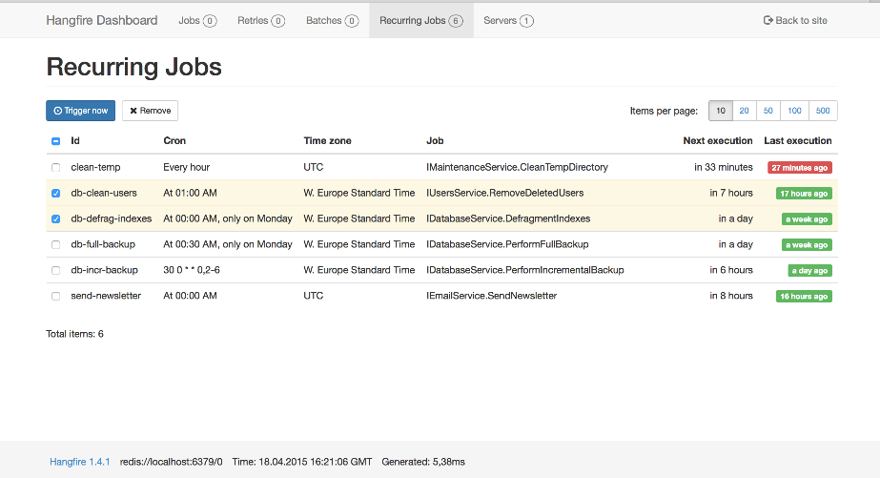
Integrated monitoring UI

Slide 8
Job Queues/Status
Enqueued: Jobs that are waiting in the queue to be processed.
Scheduled: Jobs that are scheduled to run at a specific time in the future.
Processing: Jobs that are currently being executed.
Succeeded: Jobs that have finished successfully.
Failed: Jobs that encountered an error during execution.
Deleted: Jobs that have been manually or automatically removed.
Awaiting: Jobs that are waiting for a condition to be met, such as a parent job to finish (often used in continuations).

Slide 9
Requirements and supported applications
It is possible to use Hangfire in .NET web applications, console applications, or Windows Services.
.Net Framework >= 4.5
Data base.
Newtonsoft.Json library >= 5.0.1

Slide 10
References.
hangfire.io/overview.html
docs.hangfire.io/en/latest
github.com/jackwesley/StartingWithHangfire

Slide 11
Show me some code!

Slide 12
Merci!
Thank you!
Obrigado!

Slide 13
SlidesCarnival icons are editable shapes.
This means that you can:
Resize them without losing quality.
Change fill color and opacity.
Isn’t that nice? :)
Examples:

Slide 14
😉
Now you can use any emoji as an icon!
And of course it resizes without losing quality and you can change the color.
How? Follow Google instructions https://twitter.com/googledocs/status/730087240156643328
✋👆👉👍👤👦👧👨👩👪💃🏃❤😂😉😋😒😭👶😸🐟🍒🍔💣📌📖🔨🎃🎈🎨🏈🏰🌏🔌🔑 and many more...

Slide 15
Extra graphics

